Slide 1

EMPLOYEE ATTRITION ANALYSIS
DESIGNED AND PRESENTED BY-
AYUSHI CHOUDHARY

Slide 2

PROBLEM STATEMENT
XYZ company which was established a few years back is facing around a 15% attrition rate for a couple of years. And it's majorly affecting the company in many aspects. In order to understand why employees are leaving the company and reduce the attrition rate XYZ company has approached an HR analytics consultancy for analyzing the data they have. You are playing the HR analyst role in this project and building a dashboard which can help the organization in making data-driven decisions.

Slide 3
DETAILS OF DATA
The Dataset is about the Attrition of the employees in XYZ Company.
Data analysis is done on the attrition data to understand what is the reason that employee are leaving the company.
The attributes of the data are
TOTAL EMPLOYEE
TOTAL ATTRITION
ACTIVE EMPLOYEES
AVERAGE AGE

Slide 4
ANALYSIS AND INSIGHTS
The Total Employees in the company are 4410
The Total Attrition in the company are 711
The Total Attrition rate in the company is 16.12%
The Active Employees in the company are 3699
The Average age of the employees are 37

Slide 5
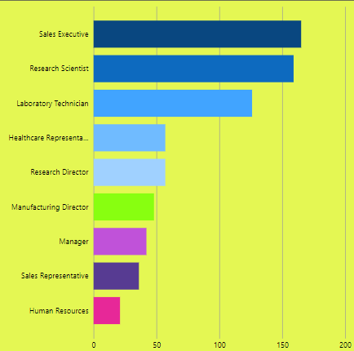
Attrition by Job Role :
The Highest Attrition by Job Role is Sales Executive and the lowest attrition is in Human Resource Job Role

Slide 6
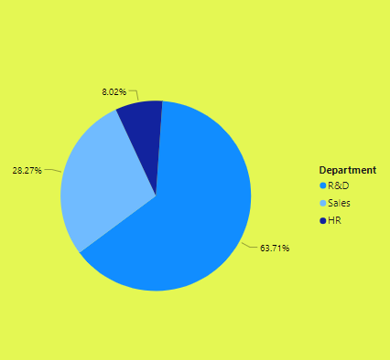
Attrition by Department :
The Highest Attrition by Department is R&D and the lowest attrition is in Human Resource Department

Slide 7
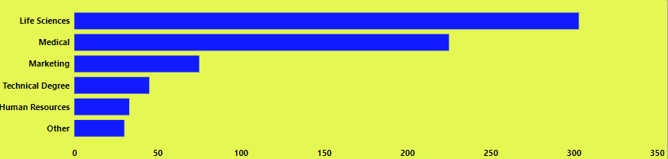
Attrition by Education Field :
The Highest Attrition by Education Field is Life Science and the lowest attrition is Others

Slide 8
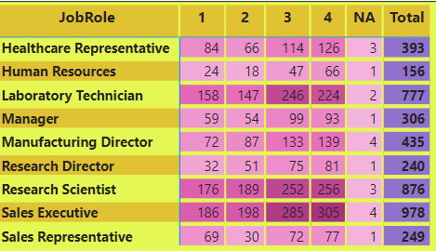
Job Satisfaction Rating :
The Highest Job Satisfied job rating is Sales Executive and the lowest rating is Human Resources.

Slide 9
Analysis Conclusion :
The Attrition in Sales Executive Job role is High because large number of people are working in this role in the company as compare to other job roles, so attrition is more visible here.
The Reason for attrition in Job Role is not more visible.
The Job Satisfaction, Work Life Balance, Income is good for Job role SALES EXECUTIVE , by Education Field LIFE SCIENCE and by Department R&D.
Need more minute and personal data to analyze the attrition reason.
As HR data analyst my suggestion would be do survey at the ground level to understand the attrition reason.

